Slide 1
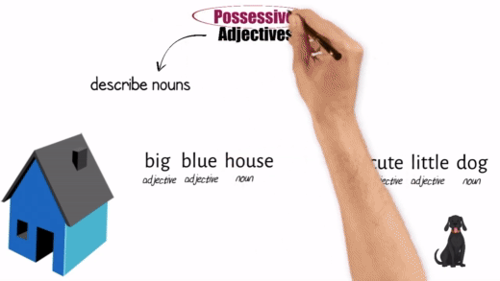
Animated explainer videos for remote learning and beyond
2021 TLSD Conference
Tools for the new normal: innovations in access, equity, and student success
INTERACTIVE WORKSHOP
Amanda Potasznik, Ph.D, Spanish & French professor, Roxbury Community College

Slide 2
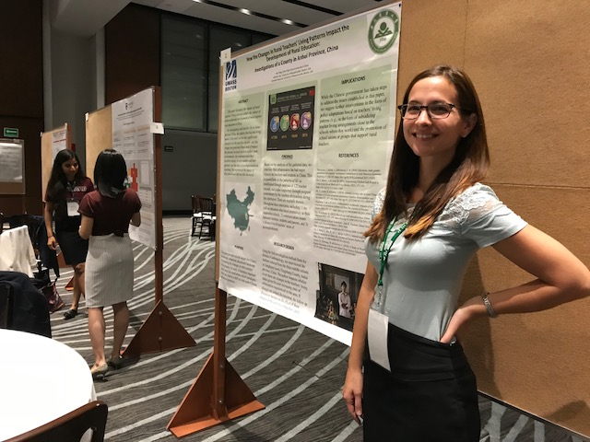
Hello!
Amanda Potasznik, Ph.D.
Spanish & French, Roxbury CC
Social Issues and Ethics in Computing, Umass Boston
LingoLearner channel on YouTube
CIES 2019
https://blogs.umb.edu/potasznikresearch/about-me/

Slide 3
A little context: Remember this?
Changing Education Paradigms
RSA Animate and Sir Ken Robinson, 2010

Slide 4
A little context: LingoLearner
(My channel!)

Slide 5
Why it’s worth doing
Time saving for instructors (in the long run 😉 )
Best candidates: Concepts that often need to be explained multiple times
Use in class as lecture tool, as homework, or for students who missed original lesson
Engaging for students
Colorful, intuitive explanations with strong visuals
No “ummms,” struggling to find good examples, pauses to erase board, etc.
Video speed can be slowed down (or sped up)

Slide 6
Why it’s worth doing (cont’d)
Notes:
Young people find a way to use YouTube (despite digital divide)

Slide 7
Why it’s worth doing (cont’d)
Animated videos keep the focus on content rather than looks and mannerisms of the instructor.
Notes:
Young people find a way to use YouTube (despite digital divide)

Slide 8
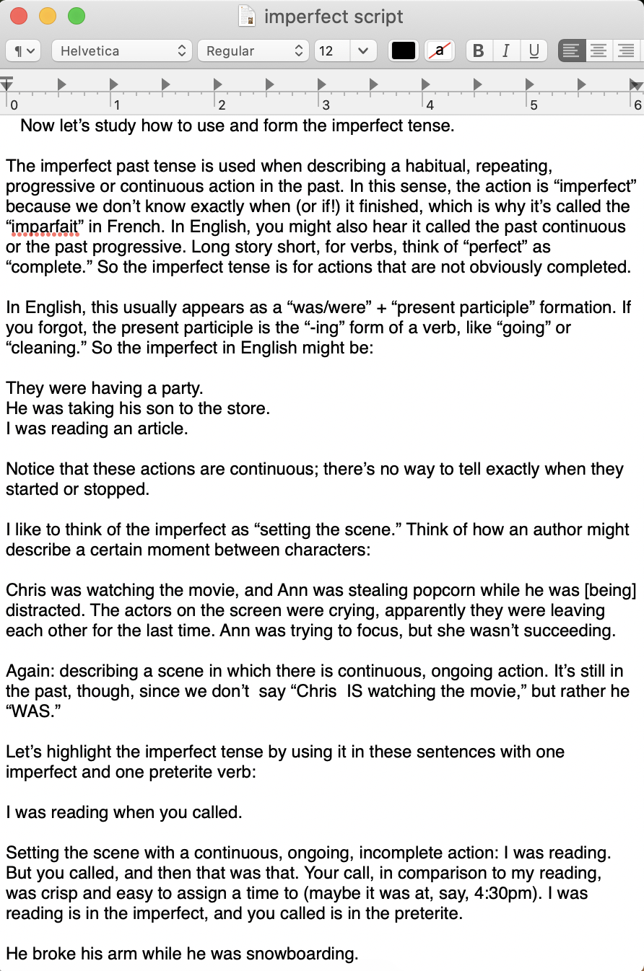
My Process: an Overview
Identify topic
Write “script”
Annotate script with basic imagery
Review steps 2 and 3 multiple times. What questions do students ask when I present this topic IRL? What parts need to be emphasized or further explained? What examples are most helpful?
Start with video creation platform!
(equation)
Include highlights here
(equation)

Slide 9
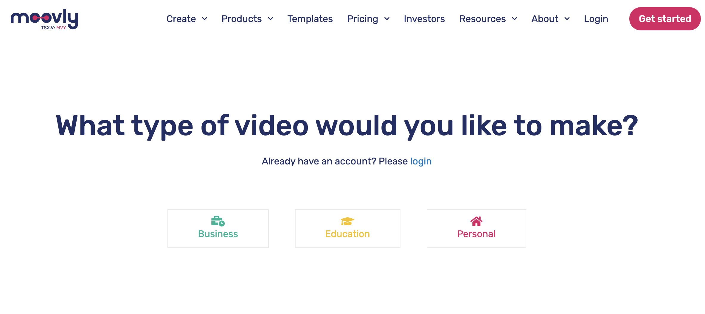
Getting Started
1
Moovly.com
2
Choose your creation platform:
PowToon
Wideo
Animaker
GoAnimate
Biteable
Animiz
Renderforest
Toonly
Explaindio
Videomakerfx
RawShorts
VideoScribe
MySimpleShow
Moovly
Easy Sketch Pro
3

Slide 10
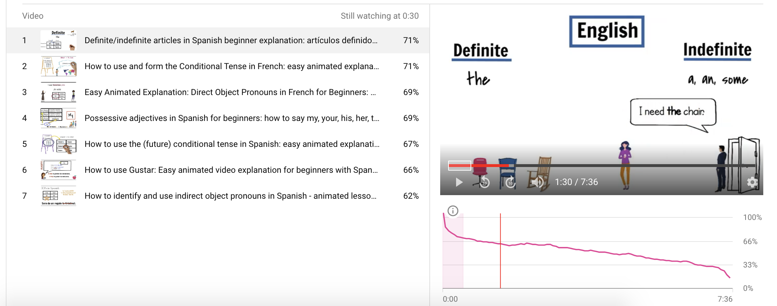
FYI
Just so you know:
Engagement analytics & trends show…
“Non-forced” viewers rarely watch for more than 3 minutes.
Discount Code for non-free plans (longer videos, more library items, etc.): UB30EDU good until 5/31/21.
Notes:
Not to say “give in” and only make 3 minute videos!

Slide 11
Studio Demo

Slide 12
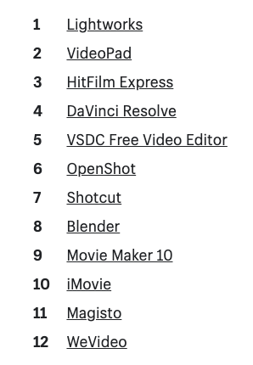
From there…
Download your animation video
Optional: add voice-over, sound, music
You can add a voice-over in Moovly itself.
Personally I do this with a different program so I can add pauses without displacing subsequent animations
iMovie (Mac)
Final Cut (Mac)
Or online versions (free and paid)

Slide 13
More resources
FreePik.com for high resolution vector images; sort for free (don’t forget attribution)
Bensound.com for royalty free stock music

Slide 14
Thank you!
Contact: apotasznik@rcc.mass.edu

